Slide 1
Group 7 Covid-19 Vaccinations
By: Logan Vielehr, Varun Challa, Sami Andrews,
Quang Phan, Bryan Xiao

Slide 2





Group Members
Sami Andrews
Logan Vielehr
Quang Phan
Varun Challa
Bryan Xiao
Team Leader
Research Coordinator
Data Analyst
Data Analyst
Data Analyst

Slide 3
Agenda
- Issue tree
- Descriptive Statistics
- Predictive Modeling
Regression and Classification Trees and Random Forrest
- Conclusion and Next Steps
Clustering

Slide 4
Objectives
Conduct Market Research on COVID-19 strategies and vaccines
Perform Descriptive Analytics to explore patterns and trends
Conduct predictive analytics
Interpret our results into insights for the client

Slide 5
Main Study Question
Sub Questions
Components Of Sub Questions
Analysis To Be Performed
Do countries with different population age distributions see different vaccination rates?
Clustering methodology
Which elements are key factors and indicators of vaccination progress?
What is the current distribution level of various vaccine types?
Descriptive analytics and bar plots to find comparative lenses
What are the factors impacting COVID-19 vaccination progress in countries?
How does GDP affect vaccination rates by country?
Linear regression models to explain correlation patterns
Which factors of developed countries translate to a particularly effective vaccine rollout?
How does different types of vaccines affect vaccination progress?
Multivariable regression model,
Regression tree model

Slide 6
Hypotheses
Countries with greater economic power and industrial force are seeing more favorable vaccination efforts
Certain vaccine types have higher success in the implementation phase but are not universally feasible
There are certain significant demographic/socioeconomic patterns acting as predictors of vaccination progress

Slide 7
Data Set variables
Target Variables:
People Vaccinated per Hundred
Total Vaccinations per Hundred
Input Variables:
Country/Region
Emissions and GDP
Vaccine types
Urban population
Population size
Population age
Total Vaccinations
People Vaccinated
Health Expenditure

Slide 8
Hypothesis 1
Countries with greater economic power and industrial force are seeing more favorable vaccination efforts

Slide 9
Main Study Question
Sub Questions
Components Of Sub Questions
Analysis To Be Performed
Do countries with different population age distributions see different vaccination rates?
Clustering methodology
Which elements are key factors and indicators of vaccination progress?
What is the current distribution level of various vaccine types?
Descriptive analytics and bar plots to find comparative lenses
What are the factors impacting COVID-19 vaccination progress in countries?
How does GDP affect vaccination rates by country?
Linear regression models to explain correlation patterns
Which factors of developed countries translate to a particularly effective vaccine rollout?
How does different types of vaccines affect vaccination progress?
Multivariable regression model,
Regression tree model

Slide 10
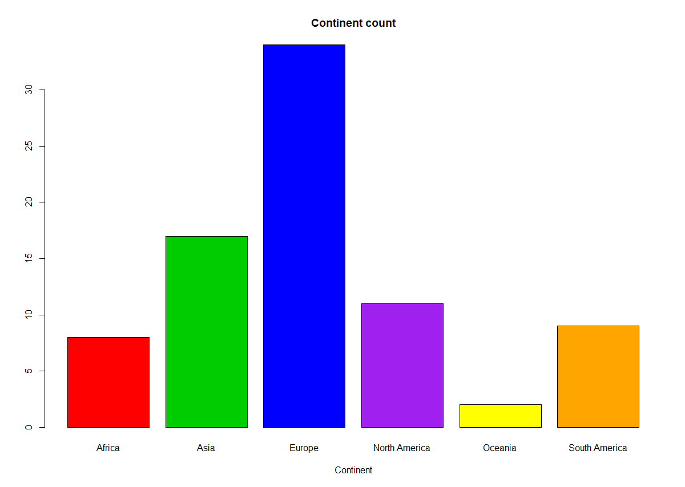
Count of countries in each continent
Africa | 8
Asia | 17
Europe | 34
North America | 11
Oceania | 2
South America | 9

Slide 11
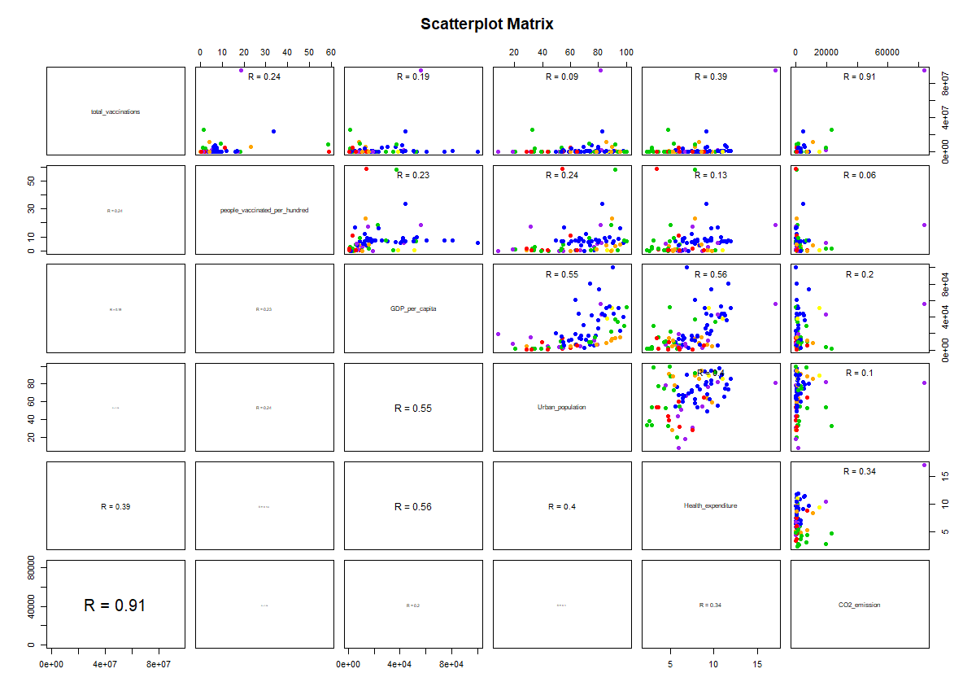
Total Vaccinations
People Vaccinated per Hundred
GDP per Capita
Africa | Red
Asia | Green
Europe | Blue
North America | Purple
Oceania | Yellow
South America | Orange
Urban Population
Health Expenditure
CO2 Emission

Slide 12
Main Study Question
Sub Questions
Components Of Sub Questions
Analysis To Be Performed
Do countries with different population age distributions see different vaccination rates?
Clustering methodology
Which elements are key factors and indicators of vaccination progress?
What is the current distribution level of various vaccine types?
Descriptive analytics and bar plots to find comparative lenses
What are the factors impacting COVID-19 vaccination progress in countries?
How does GDP affect vaccination rates by country?
Linear regression models to explain correlation patterns
Which factors of developed countries translate to a particularly effective vaccine rollout?
How does different types of vaccines affect vaccination progress?
Multivariable regression model,
Regression tree model

Slide 13
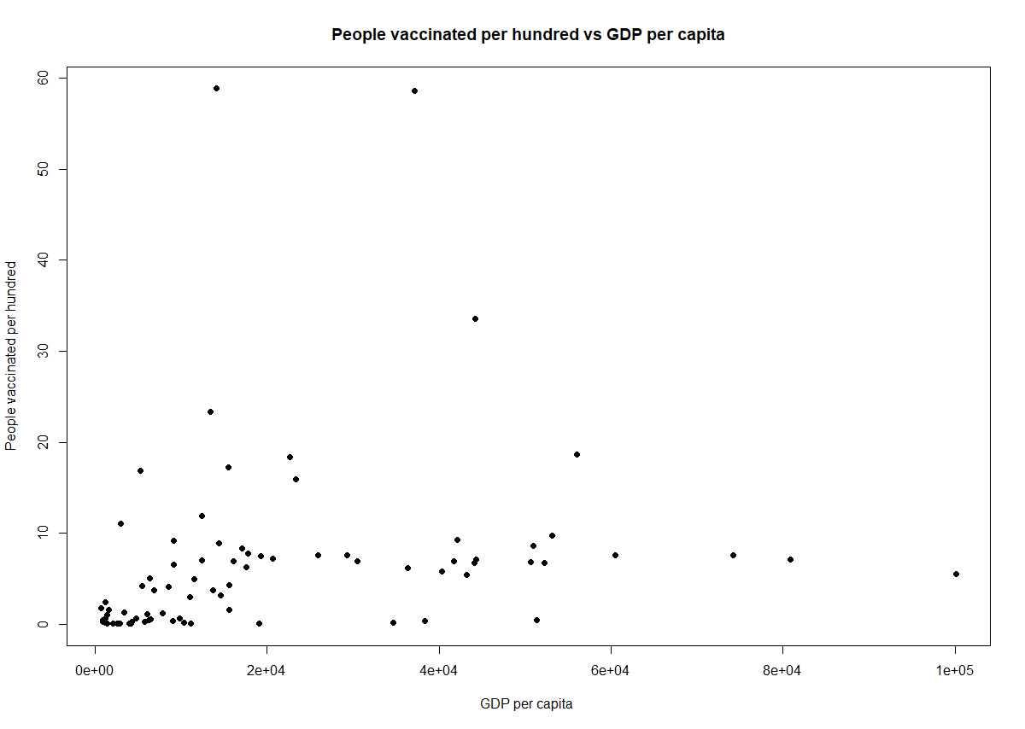
People Vaccinated per hundred vs. GDP per Capita
P-value: 0.03694
Adjusted R²: 0.04197
PV/H= 4.351(e+00)+ 1.136e-04*GDP/C
People vaccinated per hundred
GDP per capita

Slide 14
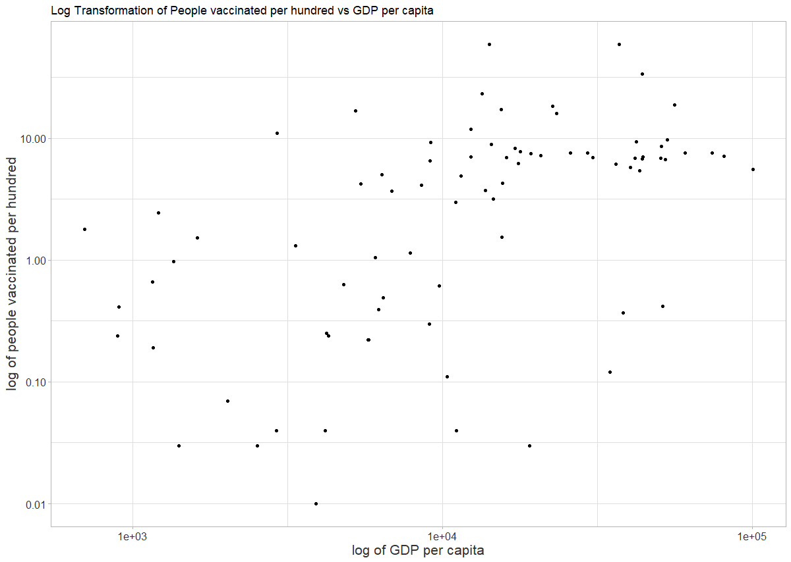
Log Transformation: People vaccinated per hundred vs. GDP per Capita
P-value: 7.243e^(-08)
Adjusted R²: 0.3001
Compare with R²: 0.04197
Log(PV/H)= -2.97747 + 0.47776*log(GDP/C)

Slide 15
Main Study Question
Sub Questions
Components Of Sub Questions
Analysis To Be Performed
Do countries with different population age distributions see different vaccination rates?
Clustering methodology
Which elements are key factors and indicators of vaccination progress?
What is the current distribution level of various vaccine types?
Descriptive analytics and bar plots to find comparative lenses
What are the factors impacting COVID-19 vaccination progress in countries?
How does GDP affect vaccination rates by country?
Linear regression models to explain correlation patterns
Which factors of developed countries translate to a particularly effective vaccine rollout?
How does different types of vaccines affect vaccination progress?
Multivariable regression model,
Regression tree model

Slide 16
Predictive Modeling
Which variables are significant in predicting total vaccinations?

Slide 17
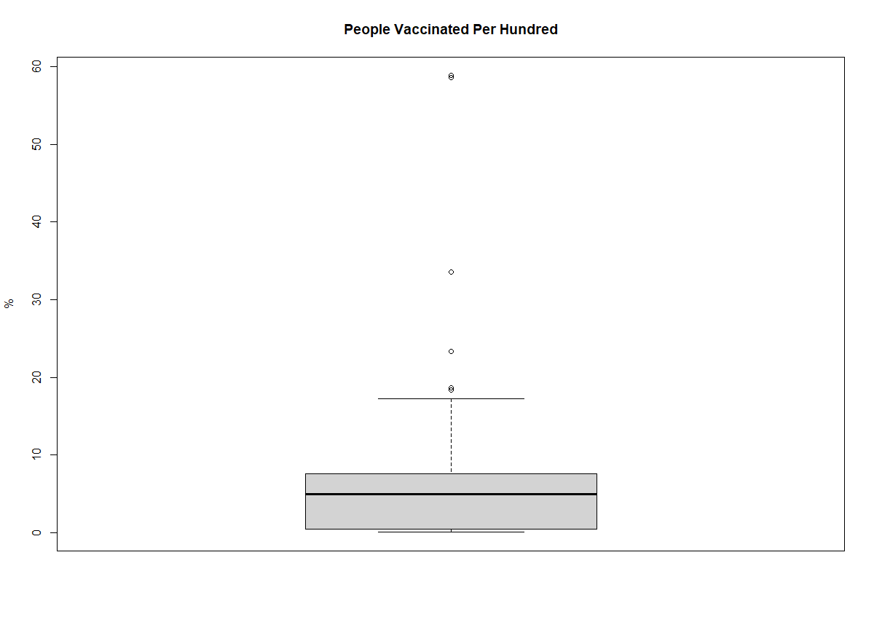
People Vaccinated per Hundred
Min | 0.01% | Guatemala
1st Qu | 0.42% | Australia
Median | 4.92% | Romania, Singapore
Mean | 6.699%
3rd Qu. | 7.54% | Kuwait, Norway
Max | 58.88% | Seychelles

Slide 18
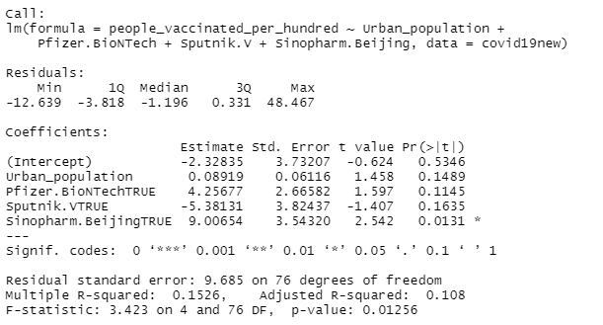
Predictive Modeling
Ran a stepwise multiple linear regression model:
Ran people vaccinated per hundred against all applicable variables in the entire data set

Slide 19
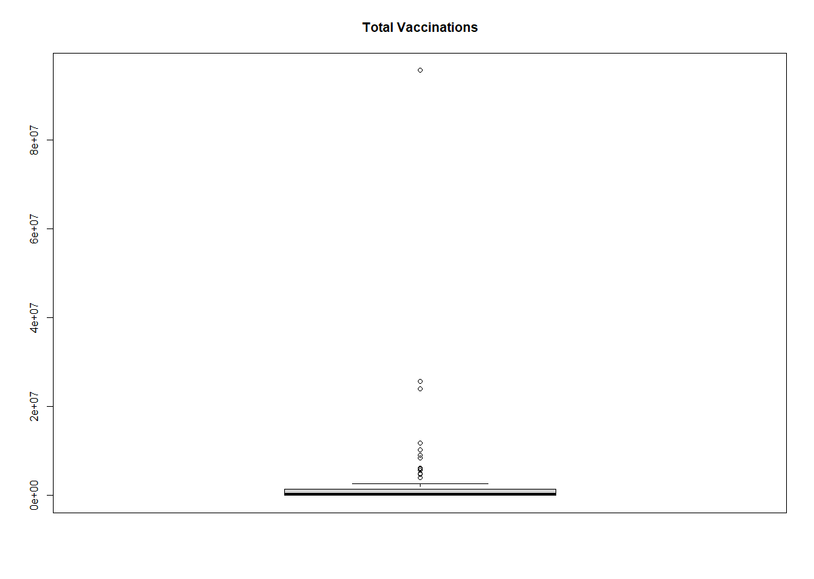
Total Vaccinations
Min | 440 | Trinidad and Tobago
1st Qu | 68017 | Senegal
Median | 309145 | Bulgaria
Mean | 3135931
3rd Qu. | 1476985 | Hungary
Max | 95721290 | United States

Slide 20
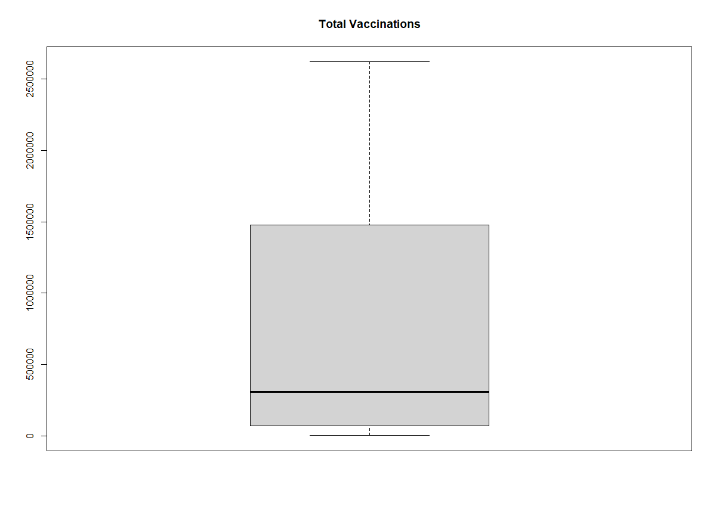
Total Vaccinations
Min | 440 | Trinidad and Tobago
1st Qu | 68017 | Senegal
Median | 309145 | Bulgaria
Mean | 3135931
3rd Qu. | 1476985 | Hungary
Max | 95721290 | United States

Slide 21
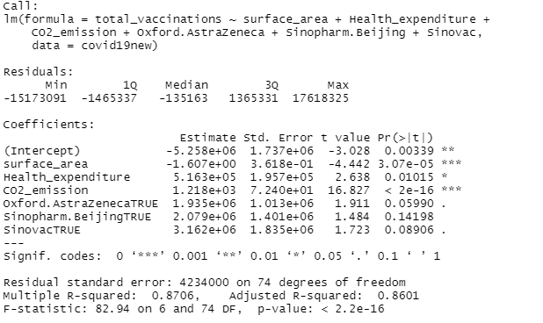
Predictive Modeling
Ran a stepwise multiple linear regression model:
Ran Total Vaccinations against all applicable variables in the entire data set

Slide 22
Hypothesis 1 Summary
More developed countries like the United States and China are seeing favorable vaccination results and progress towards total vaccination progress
Countries where vaccines were manufactured have greater vaccination outcomes
C02 Emissions and Health Expenditure are statistically significant in regards to total vaccination outcomes
Our data set is not very linearly correlated so we had to move to other methods of analysis

Slide 23
Hypothesis 2
Certain vaccine types have higher success in the implementation phase but are not universally feasible

Slide 24
Main Study Question
Sub Questions
Components Of Sub Questions
Analysis To Be Performed
Do countries with different population age distributions see different vaccination rates?
Clustering methodology
Which elements are key factors and indicators of vaccination progress?
What is the current distribution level of various vaccine types?
Descriptive analytics and bar plots to find comparative lenses
What are the factors impacting COVID-19 vaccination progress in countries?
How does GDP affect vaccination rates by country?
Linear regression models to explain correlation patterns
Which factors of developed countries translate to a particularly effective vaccine rollout?
How does different types of vaccines affect vaccination progress?
Multivariable regression model,
Regression tree model

Slide 25
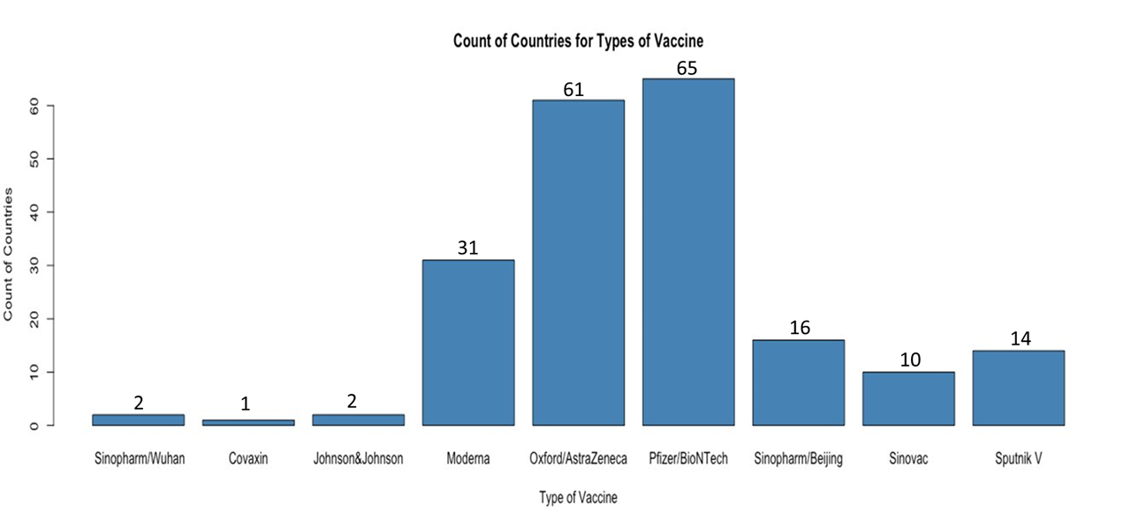
Count of Countries for Types of Vaccine

Slide 26
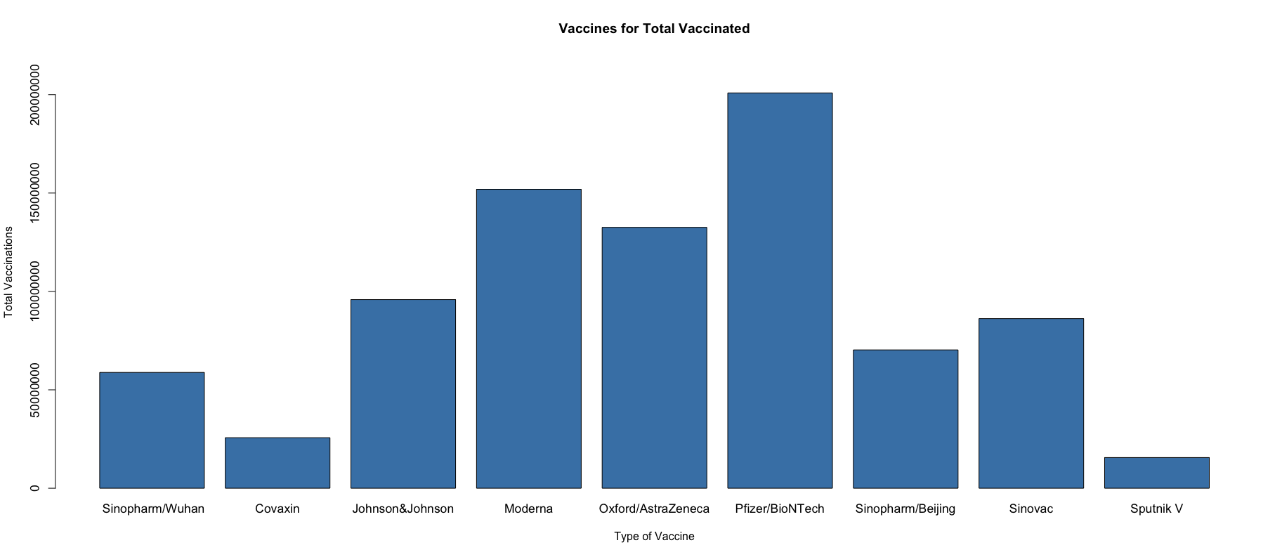
Total Vaccinations by Types of Vaccines
200,884,644
151,900,319
132,556,759
95,850,177
86,184,483
70,291,163
58,845,211
25,685,011
15,587,867

Slide 27
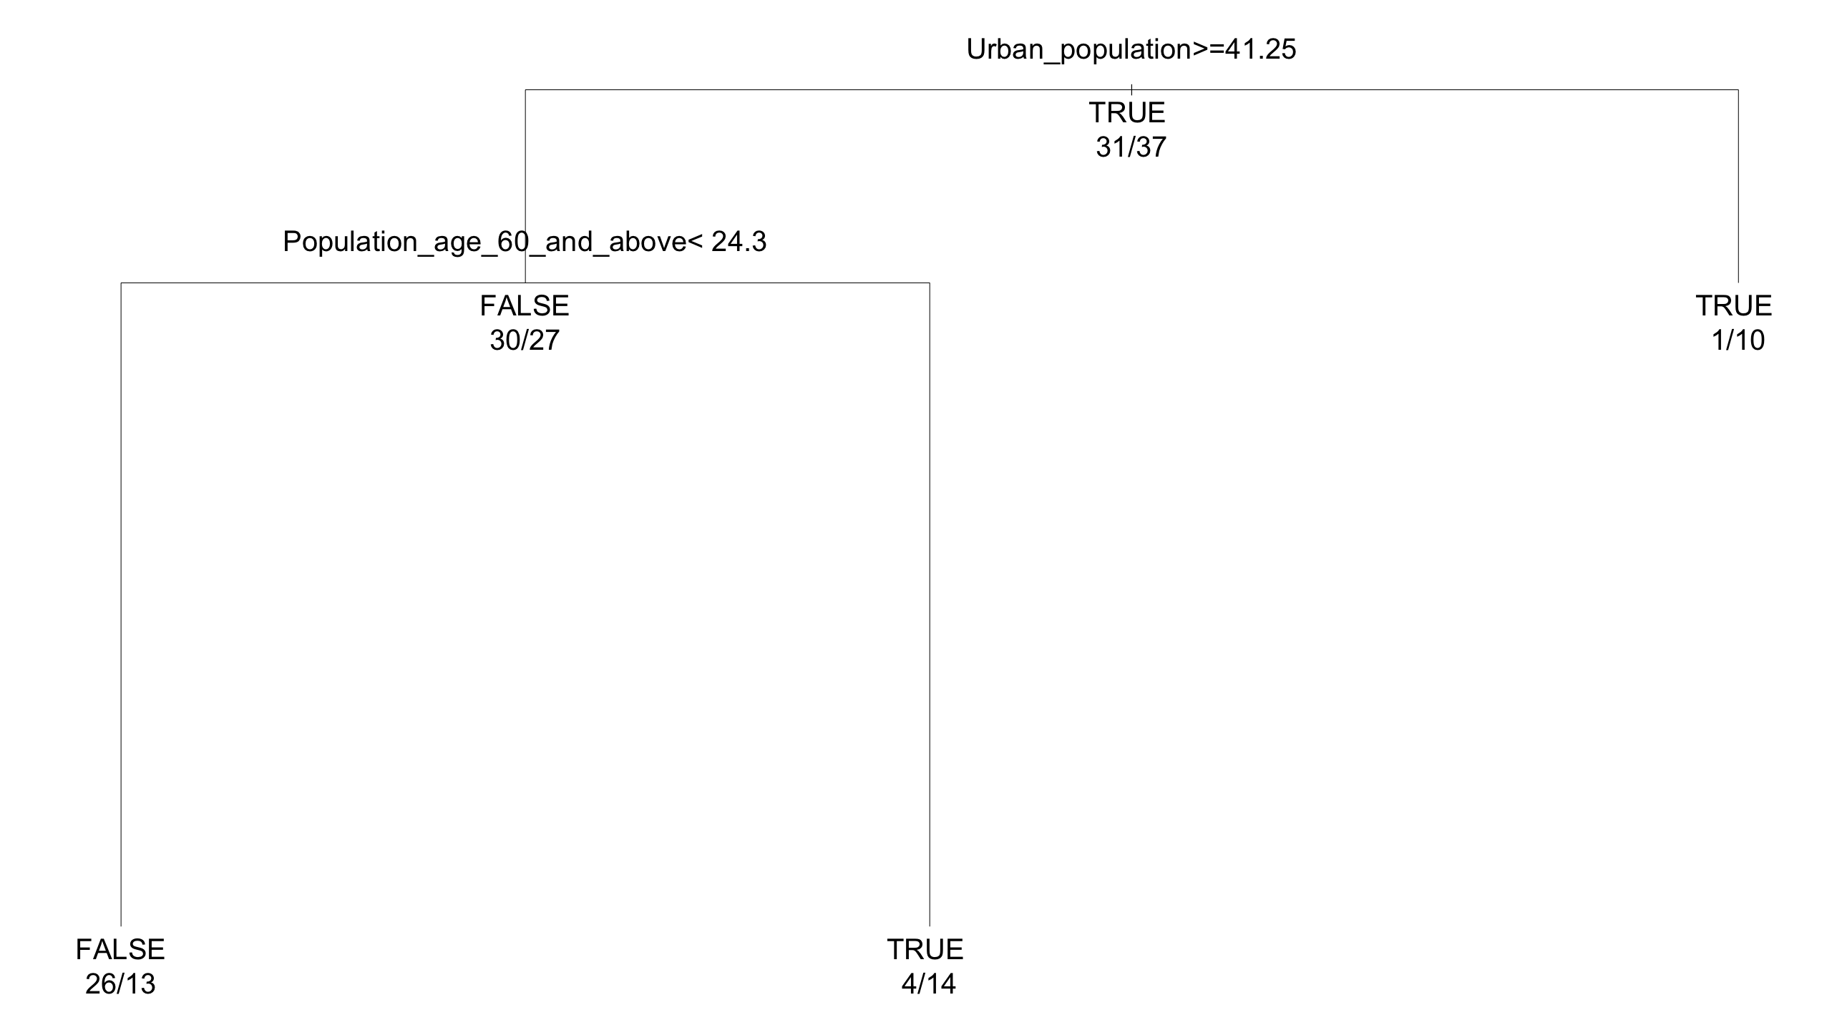
Classification Tree for Oxford Astra Zeneca
Number of Astra Zeneca = True is 37
Yes
No
Number of Astra Zeneca = False is 31

Slide 28
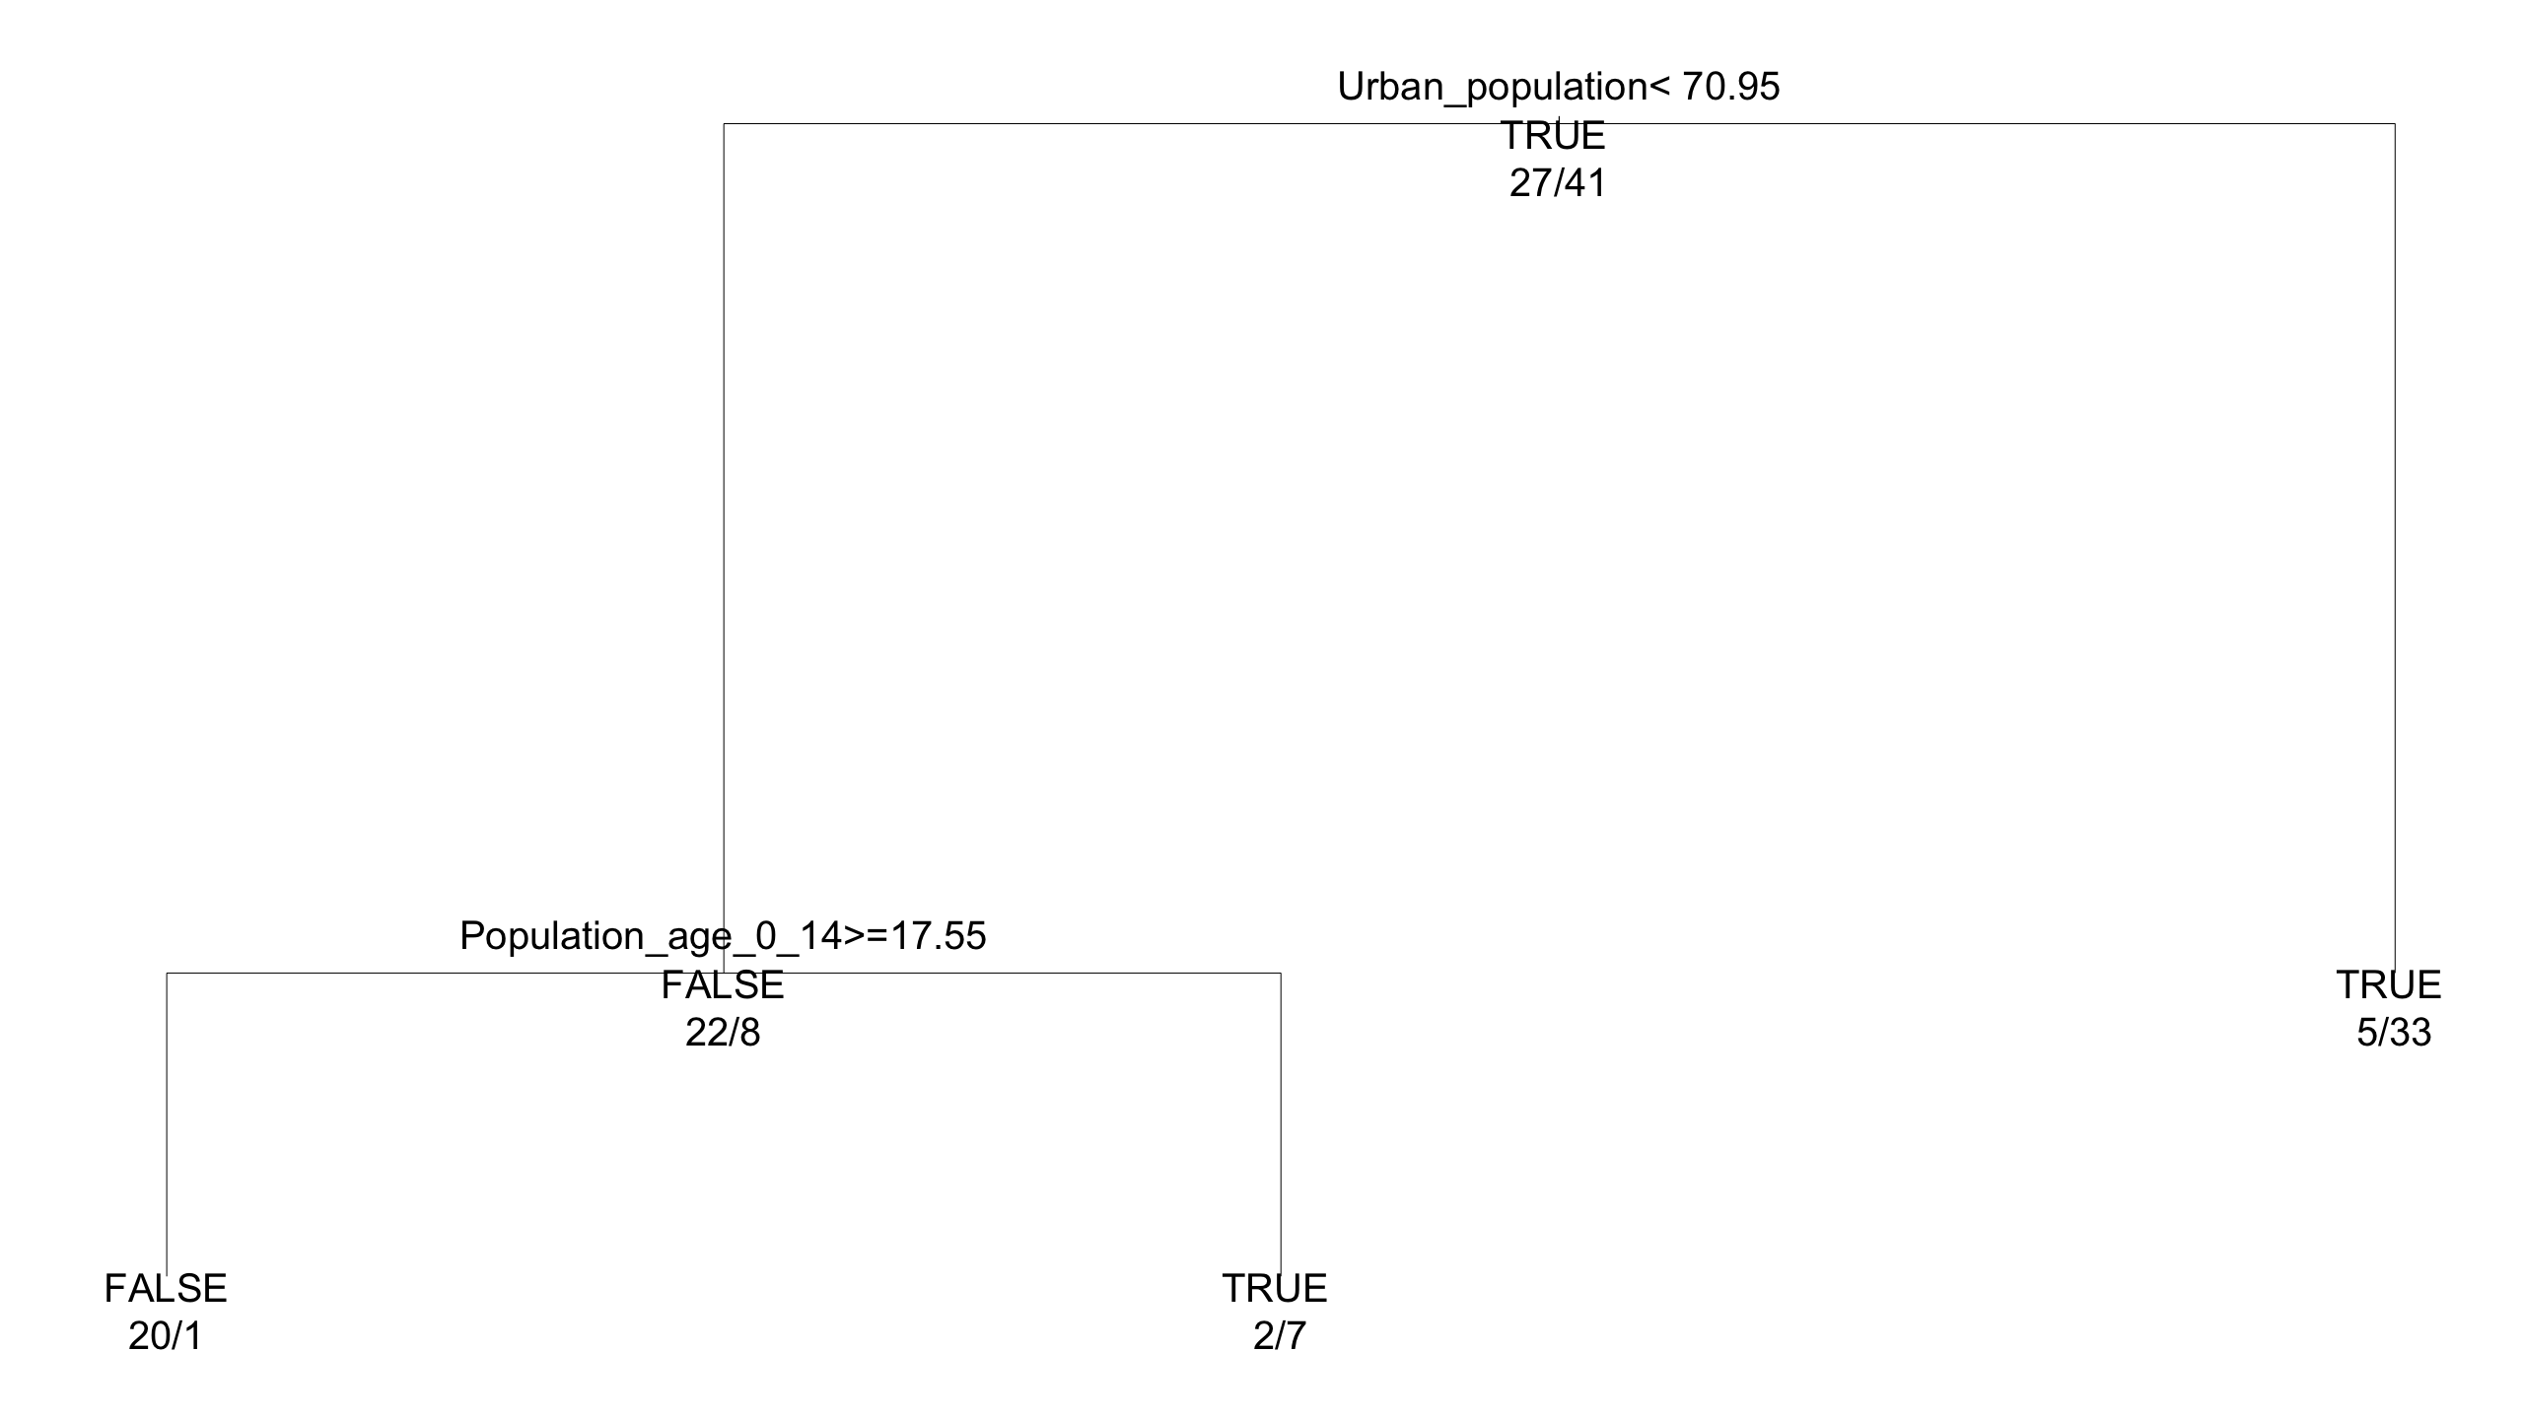
Classification Tree for Pfizer
Number of Pfizer = True is 41
Yes
No
Number of Pfizer = False is 27

Slide 29
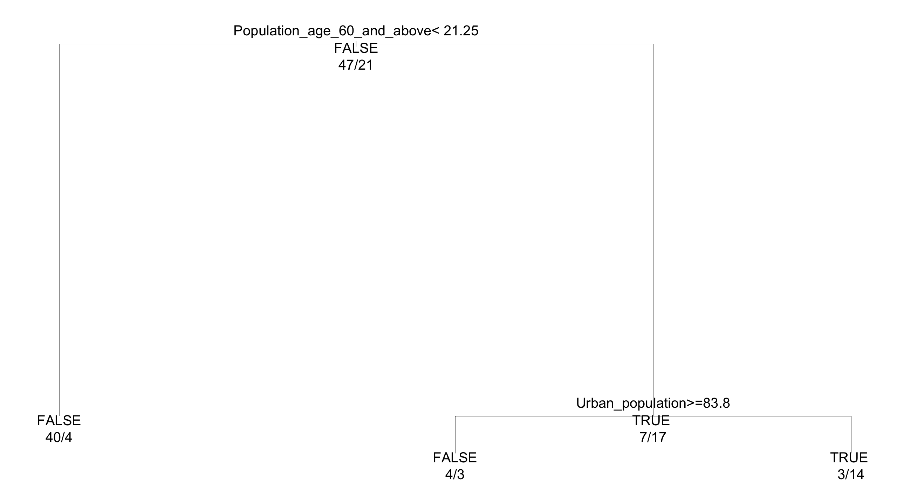
Classification Tree for Moderna
Number of Moderna = True is 21
Yes
No
Number of Moderna = False is 47

Slide 30
Cost of different COVID vaccines
Pfizer-BioNTech
Moderna
AstraZeneca-
Oxford
$19.50
$25-37
$2.15 (EU)
$3-4 (US)
$5.25 (South Africa)
Johnson & Johnson
Sputnik
Sinovac
$10
$10
$60 (China)
$29.75
*Data current as of article publication data. Prices presented in USD per dose and are subject to variation across markets.
Source: Terry, M. (2021, April 23). UPDATED Comparing COVID-19 Vaccines: Timelines, Types and Prices. BioSpace. https://www.biospace.com/article/comparing-covid-19-vaccines-pfizer-biontech-moderna-astrazeneca-oxford-j-and-j-russia-s-sputnik-v/.

Slide 31
Efficacy of different COVID vaccines
Pfizer-BioNTech
Moderna
AstraZeneca-
Oxford
95%
95%
70%-81%
Johnson & Johnson
Sputnik
Sinovac
72%
91.4%
50.38% - 91.25%
*Data current as of article publication data. Efficacy rates dependent on clinical trials
Source: Terry, M. (2021, April 23). UPDATED Comparing COVID-19 Vaccines: Timelines, Types and Prices. BioSpace. https://www.biospace.com/article/comparing-covid-19-vaccines-pfizer-biontech-moderna-astrazeneca-oxford-j-and-j-russia-s-sputnik-v/.

Slide 32
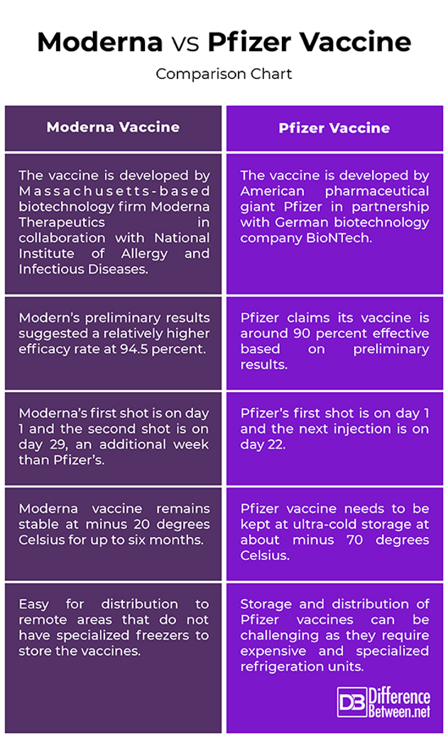
Supply chain Requirements

Slide 33
Hypothesis 2 Summary
Countries with more efficient supply chains have greater vaccination outcomes with Moderna and Pfizer Vaccines
Pfizer and Moderna are more expensive per dose than AstraZeneca-Oxford, require more support infrastructure/expenditure
Lower efficacy but longer/more easily managed shelf life may contribute to better vaccination efforts in these countries

Slide 34
Hypothesis 3
There are certain demographic/socio-economic patterns acting as predictors of vaccination progress

Slide 35
Main Study Question
Sub Questions
Components Of Sub Questions
Analysis To Be Performed
Do countries with different population age distributions see different vaccination rates?
Clustering methodology
Which elements are key factors and indicators of vaccination progress?
What is the current distribution level of various vaccine types?
Descriptive analytics and bar plots to find comparative lenses
What are the factors impacting COVID-19 vaccination progress in countries?
How does GDP affect vaccination rates by country?
Linear regression models to explain correlation patterns
Which factors of developed countries translate to a particularly effective vaccine rollout?
How does different types of vaccines affect vaccination progress?
Multivariable regression model,
Regression tree model

Slide 36
People Vaccinated by Hundred By Urban Population
*Figures are percentage vaccinated per hundred*
Low Urban Population:
Min: 0.03
Median: 8.895
Mean: 5.937
Max: 13.04
Lower Middle Urban Population:
Min: 0.03
Median: 0.52
Mean: 3.1344
Max: 17.19
Upper Middle Urban Population:
Min: 0.01
Median: 6.95
Mean: 7.368
Max: 58.88
High Urban Population:
Min: 0.04
Median: 7.66
Mean: 12.405
Max: 85.87
0 – 25%: Low Urban Population
26% – 50%: Lower Middle Urban Population
51% – 75%: Upper Middle Urban Population
76% – 100%: High Urban Population

Slide 37
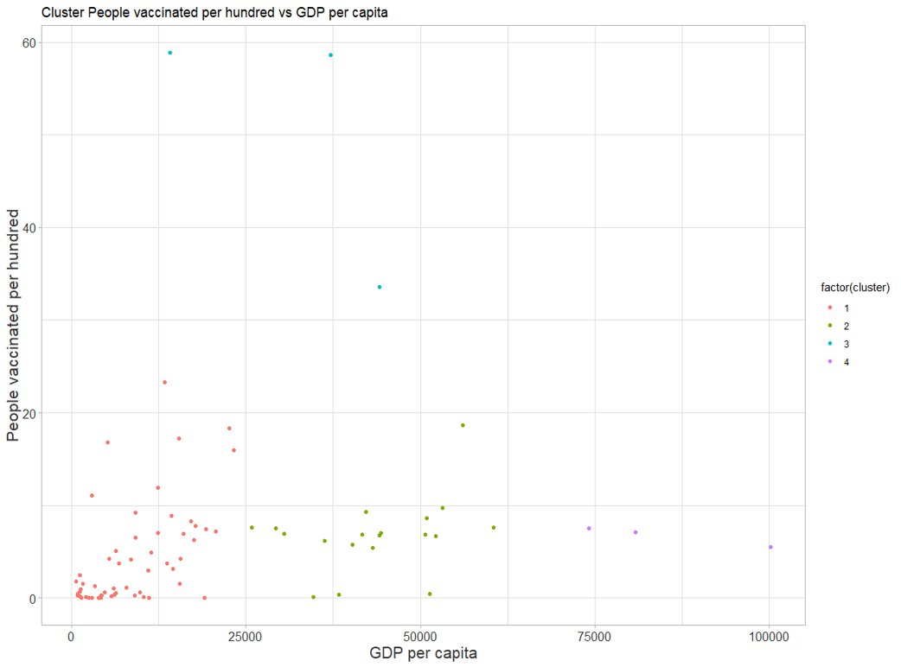
Clustering People Vaccinated per hundred vs. GDP per Capita
Data prep
Created data set of people vaccinated per hundred paired with GDP per capita
Applied hierarchical clustering with cutree where k=4
Cluster​​ | n​​
1​​ | 56​​
2​​ | 19​​
3​​ | 3​​
4​​ | 3​​

Slide 38
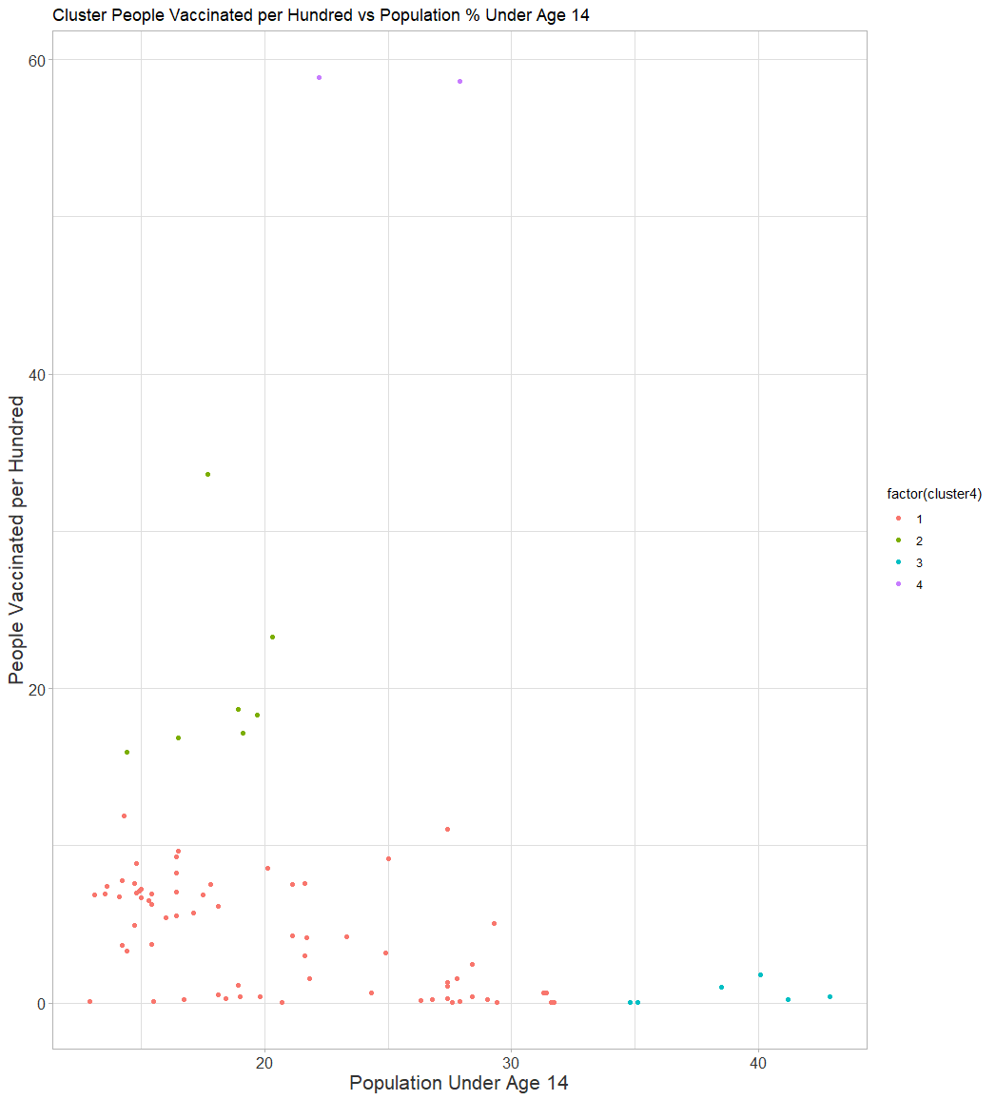
Clustering People Vaccinated per Hundred vs. Population % under age 14
Cluster​ | n​
1​ | 83
2​ | 8​
3​ | 8
4​ | 2

Slide 39
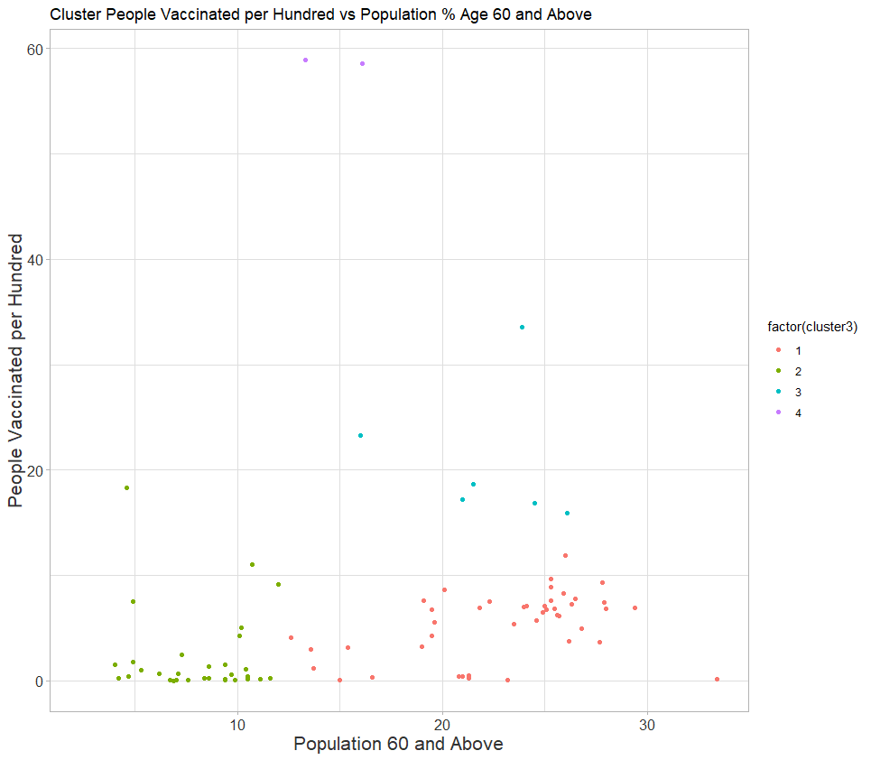
Clustering People Vaccinated per hundred vs. Population % age 60 and above
Cluster​ | n​
1​ | 48
2​ | 44
3​ | 6
4​ | 3​

Slide 40
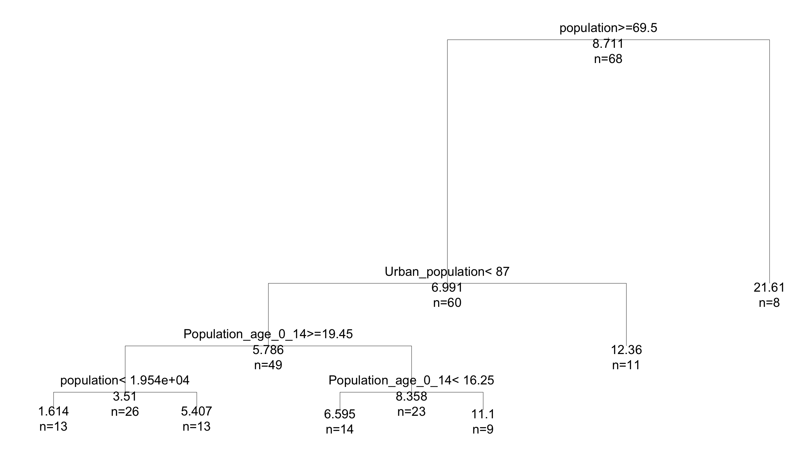
Regression Tree for People Vaccinated per Hundred
Yes
No

Slide 41
Hypothesis 3 Summary
Population age demographics matter when looking at vaccination outcomes
Countries with very large populations have much higher total vaccinations but less people vaccinated per hundred
Countries with large populations and high urban populations have greater vaccination outcomes

Slide 42
Conclusions
This data set was not very linearly correlated with our target variables so we had to find use other methods to help make better predictions
The Regression Trees helped predict the expected number of people vaccinated per hundred based off our key input variables
The Classification Trees help predict if a country should use a type of vaccine based off our input variables
Clustering showed an interesting trend about wealthy island nations and their vaccination outcomes
Health Expenditure and C02 emissions are statistically significant in regards to vaccination outcomes

Slide 43
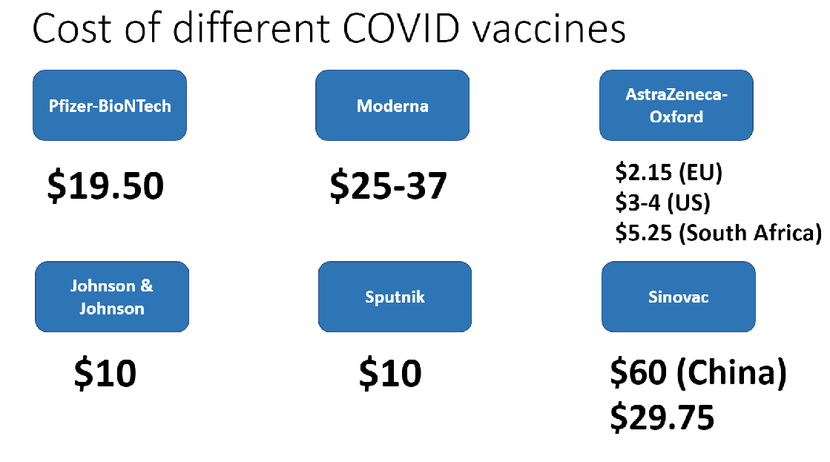
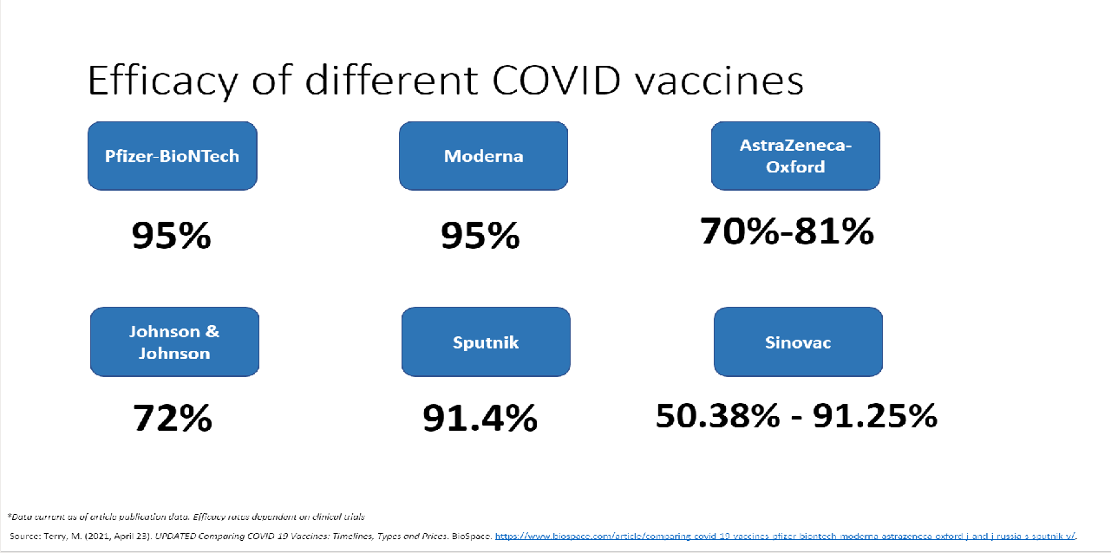
Business Insights
*Data current as of article publication data. Prices presented in USD per dose and are subject to variation across markets.
Countries where vaccines were manufactured have greater vaccination outcomes
Countries with more efficient supply chains (greater urban populations) have greater vaccination outcomes especially with Pfizer and Moderna
Pfizer and Moderna while being the most efficient vaccine have complex storage requirements and may not be the best choice for underdeveloped nations.
Sputnik is not approved by the WHO as of 21 May 2021
*Data current as of article publication data. Efficacy rates dependent on clinical trials
Source: Terry, M. (2021, April 23). UPDATED Comparing COVID-19 Vaccines: Timelines, Types and Prices. BioSpace. https://www.biospace.com/article/comparing-covid-19-vaccines-pfizer-biontech-moderna-astrazeneca-oxford-j-and-j-russia-s-sputnik-v/.

Slide 44

Thank You

